Slide 1
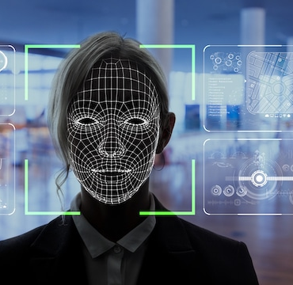
Facial Emotion Detection
By
Ram Sake
Ravi Selva
Travis Le

Slide 2
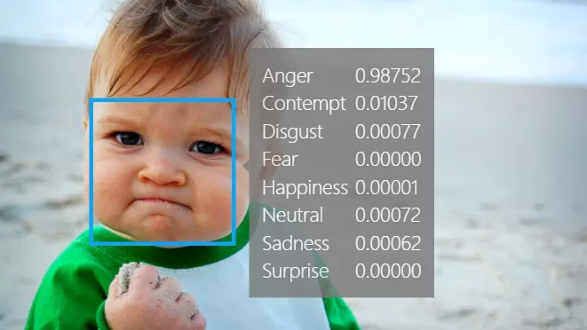
Agenda:
Overview of facial emotion detection
Facial Emotion Detection Impact to Industries
How it works (MVP)

Slide 3

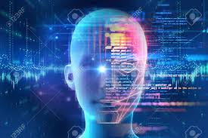
Overview of Facial Emotion Detection
As Always
Facial Detection
Facial Recognition
The human brain recognizes facial emotions automatically.
2014
2020
Facial Emotion Detection
Error rate of face identification
4.1%
0.08%
Error rate ranging between 13% - 64%
Technology Arrival
Facial Emotion Detection is the process of detecting human emotions from facial expression.
Technology has now been developed that can recognize facial expression as well.
Source: https://www.csis.org/blogs/technology-policy-blog/how-accurate-are-facial-recognition-systems-%E2%80%93-and-why-does-it-matter#:~:text=In%20ideal%20conditions%2C%20facial%20recognition,Recognition%20Vendor%20Test%20(FRVT).
Notes:
Facial Detection — Ability to detect the location of face in any input image or frame. The output is the bounding box coordinates of the detected faces
Facial Recognition — Compare multiple faces together to identify which faces belong to the same person. This is done by comparing face embedding vectors
Emotion Detection — Classifying the emotion on the face as happy, angry, sad, neutral, surprise, disgust or fear
- Technology has been emerged, not only recognize the facial image but detecting human emotions from facial expression such as happy, angry, sad, neutral, surprise, disgust or fear.

Slide 4
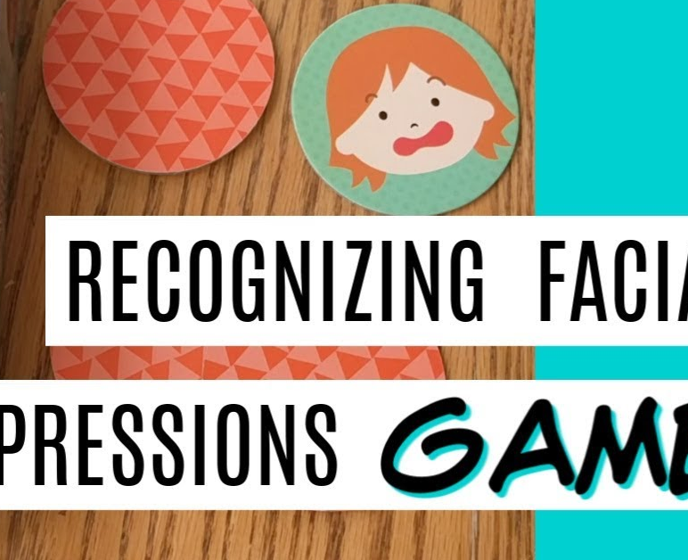
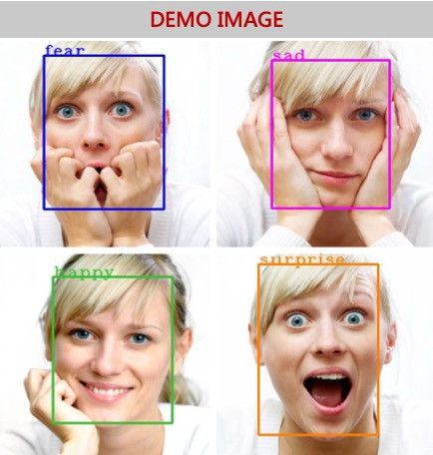

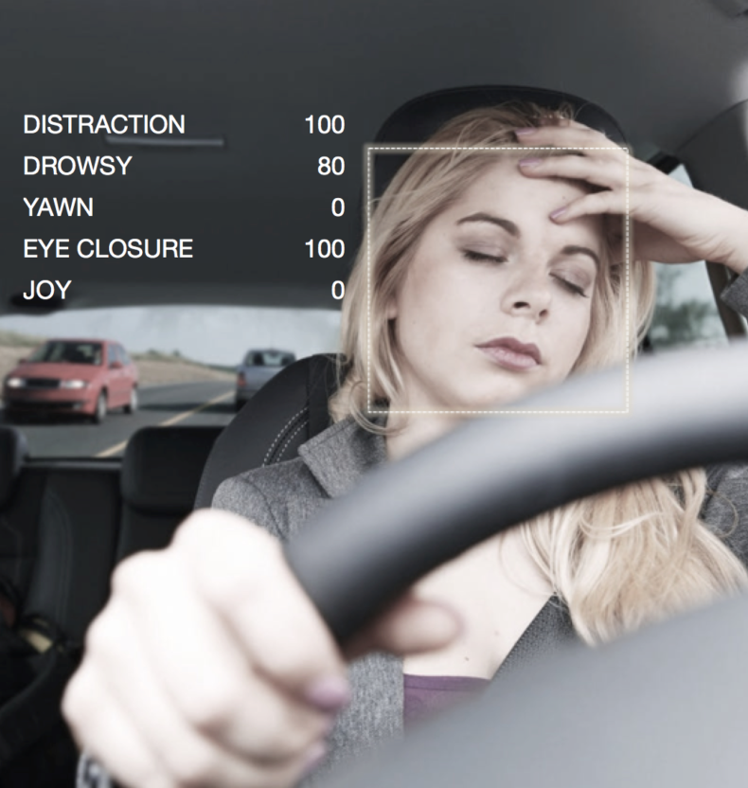
Facial Emotion Detection Adapted Wildly in 4 Major Industries
Health Care
Helping to decide when patients necessitate medicine
Assisting the physicians to determine who to see first
Automotive industry
Focusing on making cars more personal and safe
Building smart car features by understanding the human emotions
Alerting the driver when he/she felling drowsy
Video game
Evoking a particular behavior & set of emotions from the gamers
Testing the game tester and got feedback to make the final product
Understand the user experiencing in real-time
Social marketing
Tailoring the marketing on the spot of emotional reactions
Source: https://sightcorp.com/knowledge-base/emotion-recognition/;
https://blog.hubspot.com/marketing/emotion-detection-technology-marketing
https://www.thalesgroup.com/en/markets/digital-identity-and-security/government/biometrics/facial-recognition
Notes:
Emotion recognition is already widely used by different companies to gauge consumer mood towards their product or brand. The opportunities brought by this technology goes further than market research and digital advertising.
Emotion recognition in Health Care: An industry that’s taking advantage of this technology is Health Care, with AI-powered recognition software helping to decide when patients necessitate medicine or to help out physicians determine who to see first.
Automotive industry and emotion recognition: The automotive industry is also applying emotion recognition technology, as car manufacturers around the world are increasingly focusing on making cars more personal and safe for people to drive. The latter is a chiefly attention-grabbing area and one that various companies have by now taken steps in testing and researching. In their pursuit to build more smart car features, it makes sense for car manufacturers to use AI to help them understand the human emotions. Using facial emotion detection smart cars can alert the driver when he is feeling drowsy.
Emotion recognition in video game testing: Video games are designed with a specific target audience in mind and aim to evoke a particular behavior and set of emotions from the users. During the testing phase, users are asked to play the game for a given period and their feedback is incorporated to make the final product. Using facial emotion recognition can aid in understanding which emotions a user is experiencing in real-time as he or she is playing without analyzing the complete video manually.

Slide 5




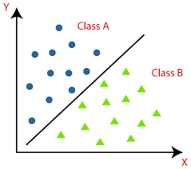
High level Workflow of Facial Emotion Detection
Camera / Video
Emotion Image
Face Detection
1
2
3
Prediction
Classifier
Grayscale and Crop
6
5
4

Slide 6
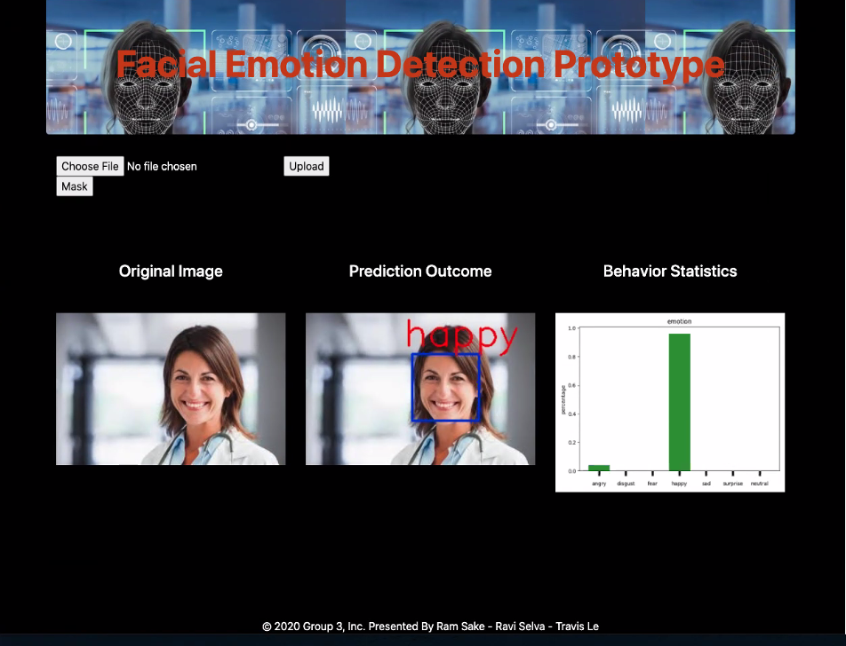
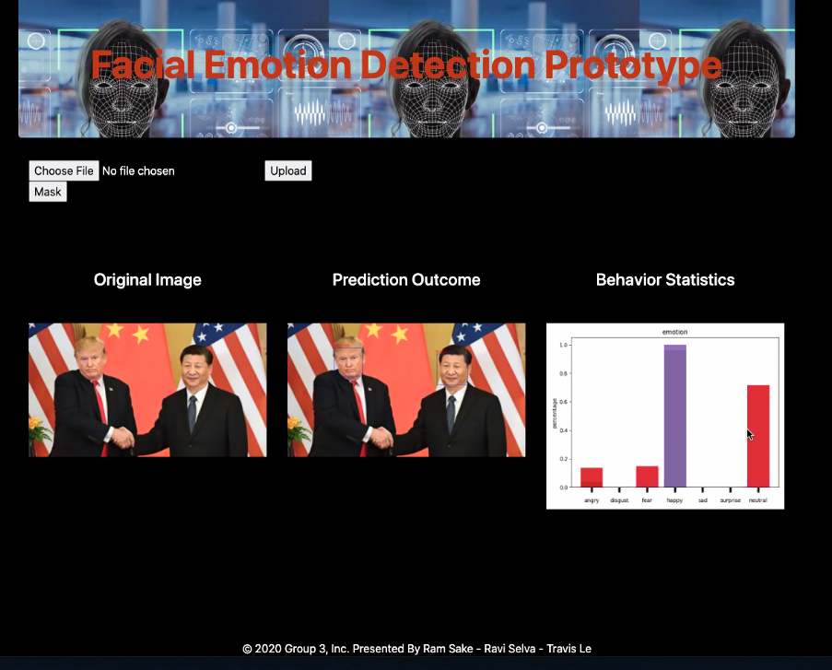
User Friendly Platform
1
2
1
2
3
4
5
3
4
5

Slide 7
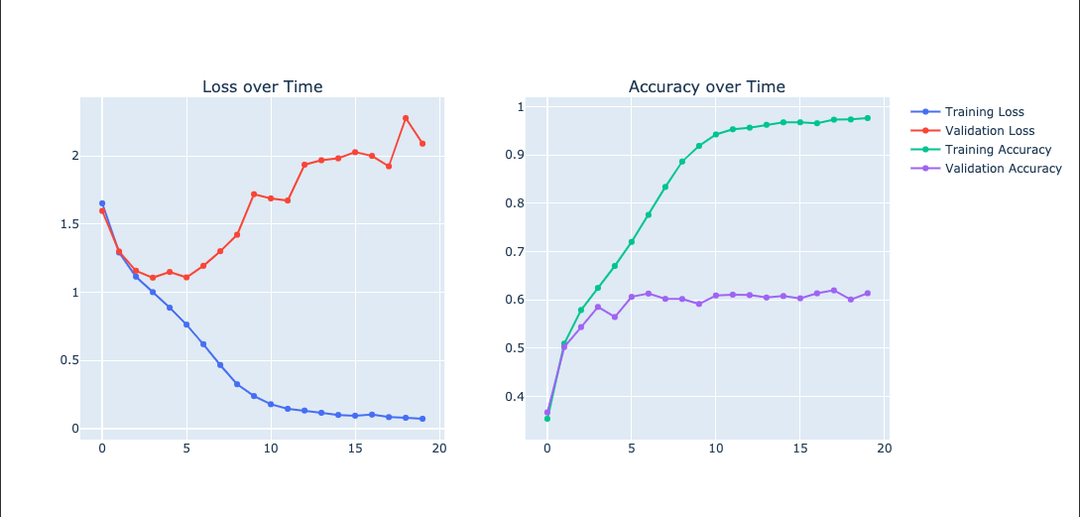
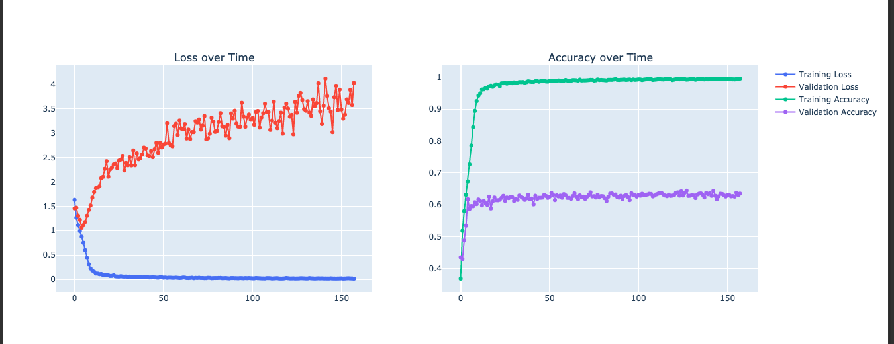
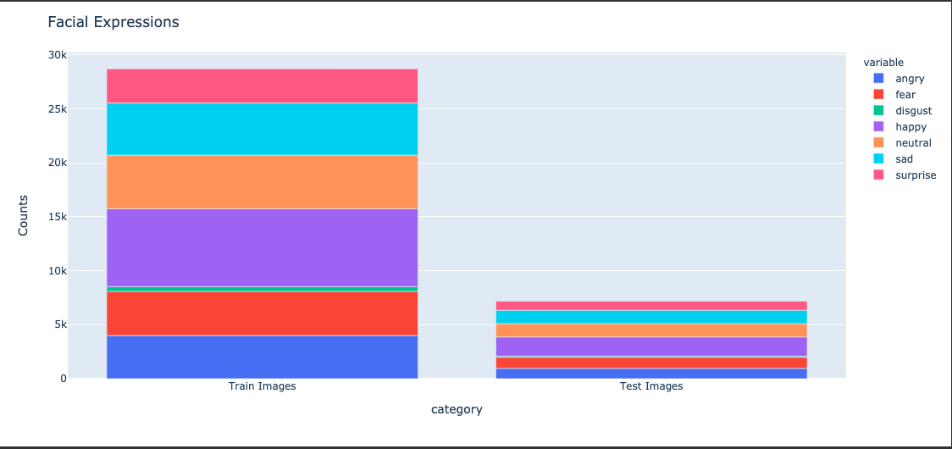
Emotion data model: Optimal training vs. Overfitting
20 Epochs - Optimal
150 Epochs - Overfitting
Technology implication:
Convolutional Neural Network with 2 levels of deepness
Activation as relu, softmax
Optimizer as Adam
Training image: 28,709
Testing image: 7,178
Training Accuracy: 97%
Validation Accuracy : 61.4%
In scope:
Emotion detection in the picture and video
Behavior statistics
Future scope:
Live mask detection
Live emotion detection
Real-time behavior analytics
Number of Image for training and testing
Source: team analysis
Notes:
For emotion data model optimal training and Overfitting, we apply Convolutional Neural Network with 2 levels of deepness. We find out that the optimal training has 20 number of passes through the training dataset and Overfitting training has 150 number of passes through the training dataset.
An epoch is a term used in machine learning and indicates the number of passes of the entire training dataset the machine learning algorithm has completed.

Slide 8
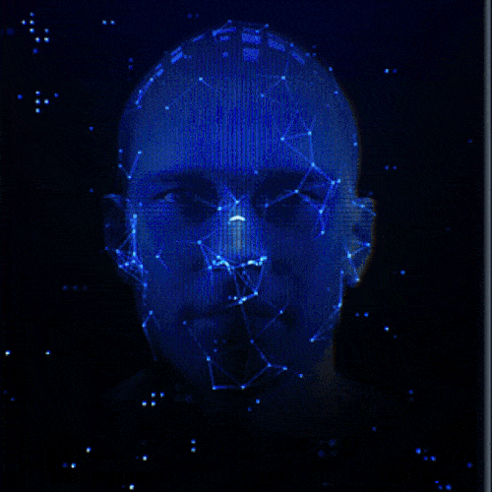
Demo

Slide 9


Special “THANKS” to:
Alexis Wong Baird
Amanda Robinson
Nino Yosinao

